Slide 1


Creative x
May 2021

Slide 2
agenda
01.
04.
What is creative x?
Proposed cost and roll out
02.
05.
Kia case study
Wrap up and questions
03.
O2 proposed use cases

Slide 3
What is creative x?
01.

Slide 4
EXPLORE AND ESTABLISH RELATIONSHIP BETWEEN CREATIVE DESIGN AND PERFORMANCE

Slide 5

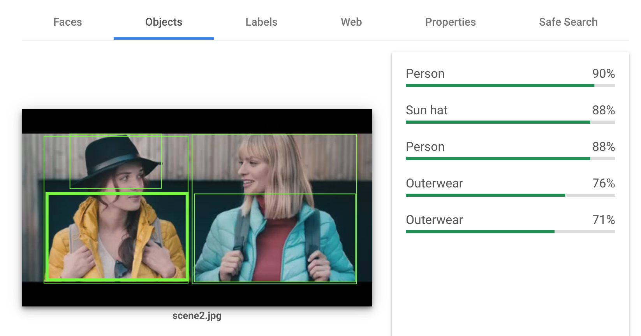
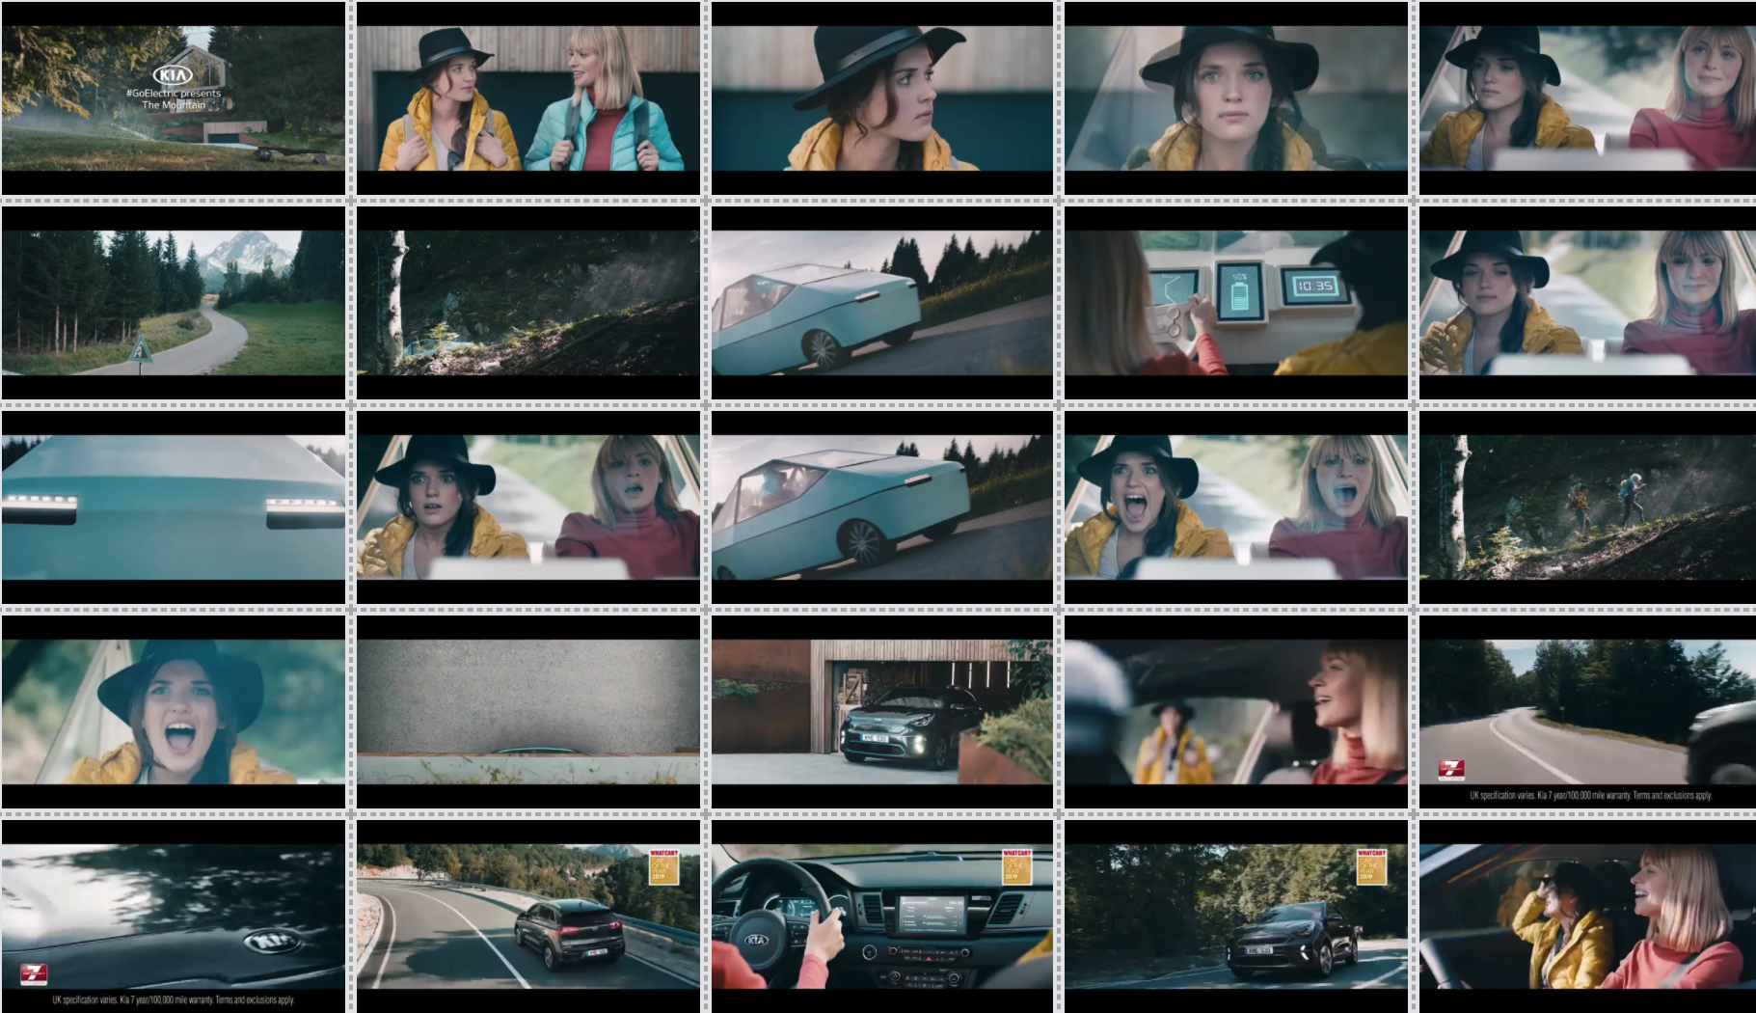
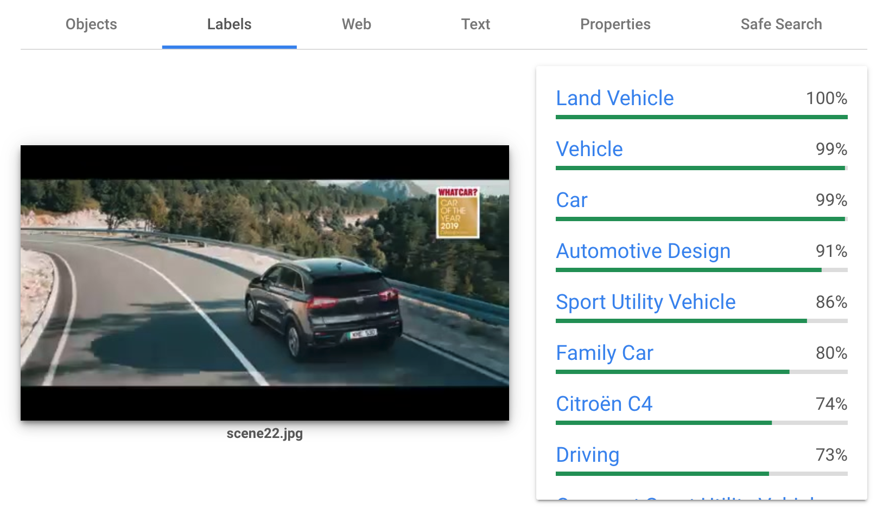
VIDEO INTELLIGENCE API + VISION API TOGETHER
Computer Vision is able to detect scenes and captures screen shots frame by frame. Objects, Entities, Texts, Brand Logo etc. can be identified using the Deep Learning ML Models.
The ML algorithm is also able to detect facial expressions, emotions & colour prominence among other things.
SCENE DETECTION

Slide 6

A Collaborative Workstream between the Data Engineering teams of Havas Media Group & Google

Slide 7
how does it work?
01
02
03
04
REQUIREMENT GATHERING & HYPOTHESIS DESIGN
We work with you to fully understand the objective of the campaigns, the target/opportunities audience and design brand specific principles that we wish to test.
The project would kick off with a workshop between you, your existing team at Havas and the data scientists & engineers that have built Creative X.
PROCESS THE VIDEO & IMAGE CREATIVES USING COMPUTER VISION ALGORITHMS
The creatives are processed via Video and Vision API. The extracted content features are stored in Google Cloud Platform.
MACHINE LEARNING MODELS TO CREATE MEANINGFUL CLASSIFICATIONS & LOCALISED NARRATIVES
Advanced ML (NLP, Neural Networks) are trained to create meaningful segments based on hypothesis
INSIGHT GENERATION & EMBEDDING RESULTS IN CREATIVE DESIGN & PLANNING
The models are overlaid on to the campaign performance datasets. Insights are then generated and fed back to the Creative Teams who can take a more data driven approach in Creative Design
Notes:
NLP = neural linguistic progamming
Neural networks = Deep learning is a form of machine learning, inspired by human brain neural networks

Slide 8
A NOTE ON data securitY
24/7/365 Encryption
The data in the cloud remains encrypted and can only be accessed by authorized roles. Permissions that can only be provided by our Database Administrators.
Two-way authentication is required to access the datasets in-house. Every dataset has added layer of security and roles. Even with the access to the cloud, you can only view a specific dataset, if you are given adequate access rights.
Communications over the internet to cloud services are encrypted in transit.
Security at the heart of Google Cloud Technology
Extra security & obfuscation for Users and Identity datasets
Phishing resistant Titan Key Security
6 Layered Deep Physical Data Centre Security
24/7/365 cloud maintenance ensuring no loss of data or services.

Slide 9
2 streams of insights
Creative Design Principles
Same questions that could be applied to every campaign:
E.g. What’s the optimal amount of text per scene?
E.g. What’s the optimal frame length?
Campaign Success Drivers
What is the distinguishing factor that has led to the success or failure of a given campaign?
E.g. iPhone 12 release campaign

Slide 10
Why is creative x the best on the market?
Architecture Built to lend Scalability
Our AI tool can process a million creatives in a 24-hr window with unlimited storage capacity.
AI Hub allows flexibility for Custom Models
Reduces reliance on Google built Machine Learning models. Cloud architecture has allowed productionisation of our own models that can be customized based on the requirements.
Media Activation
Performance Datasets, DCO & Creative X work in tandem inside the Big Data Environment at Havas, allowing faster optimization opportunities.
Ever-evolving
We’re not done yet! Work is underway to develop sentiment analysis and speech to text transcription, digital signal processing as well as music classification to further enhance the insights from the tool
Google Backed
The development of the tool and the capability was a result of a collaborative work between the Data Science and Engineering teams of Havas and Google.

Slide 11
Kia case study
02.

Slide 12
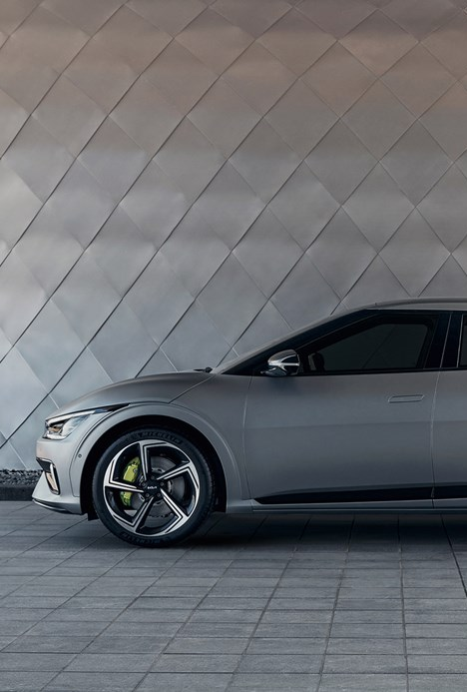
Measures of success
We processed over 400 Kia video and image creatives using the Video and Vision API
Key performance Indicators:
Click through rate
Video completion rate
The creative features analysed in this phase:
colour palette
object annotation
facial expression
text annotation
Alongside the Creative X program, a survey was conducted to assess the creative quality of the assets, this enabled us to combine the performance data with notions of originality and artistic value as well as trustworthiness.

Slide 13
hypotheses
Early display of brand performs better
Automobile creatives with schematic & blueprints perform better
Bright Colours make the creative more visually pleasing & hence perform better
Happy faces in creatives perform better
Creatives showing landscapes perform better
Fast scene transitions engage the user and increase VTR

Slide 14
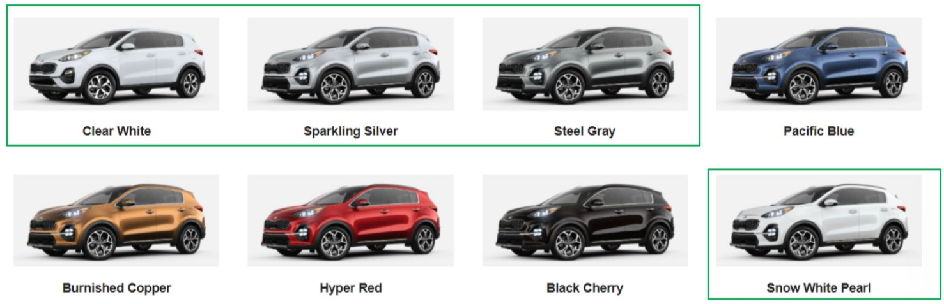

Kia INSIGHTS GENERATED FROM 400+ CREATIVES
SHOULD THE BRAND BE MADE VISIBLE EARLY TO IMPROVE STICKABILITY?
HOW QUICKLY SHOULD WE MOVE FROM ONE SHOT TO ANOTHER?
THE PSYCHOLOGY OF COLOURS : GO NEUTRAL!
Early display of brand takes away the element of surprise and result in reduced engagement with the Creative. Creatives where logo appear within the first 5-10 seconds have 20% lower Video completion rates.
+24%
Finding: The average frame length for a Kia creative is 2.5 seconds!
With Kia, we have seen that creatives with average frame length of 4-8 seconds generate 35% more CTR over creatives with shorter frame length
The best performing colours of the automotive were found to be neutral earth tone colours. Although Pacific blue is the predominant colour of the Cars appearing in the creatives, the creatives with Silver, Gray and White Coloured cars have a significantly higher Video Completion rates (c.12%).
VIDEO COMPLETION RATE
56%
45%
>10 sec
<10 sec
+35% CTR
AVG. SHOT LENGTH (4-8 SEC)
BRAND DISPLAY | VIDEO COMPLETION RATE
>10 Seconds | 56%
<10 Seconds | 45%
LOWER CTR
+24% VTR
+35% CTR
+12% VTR

Slide 15
Proposed o2 use cases
03.

Slide 16

Kpis and outcomes
As with the KIA case study, recommend tracking success through CTR and VTR but also exploring other metrics like
Total watch time
Proportion of video watched
As well as determining the success of each feature, the Creative X tool can also assign an importance to each creative component
Notes:
Proxy for attention
High VTR contributes to quality score -> cheaper ads

Slide 17
Continuous upload of ongoing activity to fuel the data pool
ONGOING ACTIVITY
Facebook
Snapchat
Flashtalking/Teads
Instagram
YouTube
CREATIVE DESIGN PRINCIPLES
+
DATA POOL
DCO enhancement
CAMPAIGN ROADMAP
iPhone 12 release
Black Friday
Christmas
Combination of brand and offer campaigns contribute to creative design principles, and providing campaign specific results if sufficient data
12+ months of data collection will allow for seasonal comparisons
Notes:
Change ad creative to optimise performance per audience. For example, what is most compelling to customers vs prospects. The activation automation can happen anywhere DCO can automate. Google unskippable labs have done research work on it on close to 100k video creatives and performance datasets.

Slide 18
Wider content automation
CAMPAIGN ROADMAP
iPhone 12 release
Black Friday
Christmas
Creative X Data pool
ONGOING ACTIVITY
e.g.
Instagram, Facebook, Youtube, Snapchat
etc.
New learning phase for Creative X algorithm
New learning phase for Creative X algorithm
Point of creative asset refresh
Point of creative asset refresh
DCO over time
As with Creative X, DCO is always on; with DCO working to generate the optimal ad per audience group. At points of creative refresh, new assets will be introduced.
CAMPAIGN ROADMAP
iPhone 12 release
Black Friday
Christmas

Slide 19



WHICH ASPECT OF DCO DOES CREATIVE X ANALYSE?
Continue to iterate experiments to maximise success
DCO
CREATIVE X
Automation of the permutations: Breaks down the ad into attributes and tests different attribute variables on different audiences. Attributes include, length of the ad, messaging, colour scheme, location, weather, demographic interaction
Takes the visual creative module and breaks it down to establish the cause of its success. Example result:
A
C
B
D
16% VCR
17% VCR
E
F
G
5% VCR
4% VCR
H
I
J
15% VCR

Slide 20
How often should the creative design principles be reassessed?
With asset refreshes
Each time the creative assets are refreshed Creative X will enter a new phase of learning. At this point the creative design principles should be re-evaluated, both independently and aggregated with the previously collected data to give a clear picture on which design principles would need updating.
Annual campaign launches
With campaigns such as iPhone releases and Black Friday the learnings from previous years should be taken forward into the new launch. The current year’s campaign should be analysed to provide aggregate and independent learnings for the next seasonal launch.

Slide 21
Key creative components of an ad
1
Structure
Size, clearly defined borders, scene transition, frame length
4
Visual Content
People, landscape/location, weather, activity, sentiment
2
Branding
Logo, slogan, familiar colour scheme
5
Call to Action
Button placement and time positioning, phone number
3
Value proposition
Text, pricing, key message, sentiment
Notes:
Each of these components should be tested in order to maximise creative performance

Slide 22
Proposed cost + roll out
04.

Slide 23
Proposed investment fund structure
One off brand analysis, one market £25,000
Ongoing analysis per market, per quarter £10,000
Unlimited assets to be analysed
Maximum of 6 hypothesis per test to be analysed
Timeframe required to produce analysis 4 weeks post receipt of all assets

Slide 24
Thank
Thank
you
you

